Slide 1
Electronic Devices and Circuits Lab 03 – Deboo Integrator
Lab overview

Slide 2
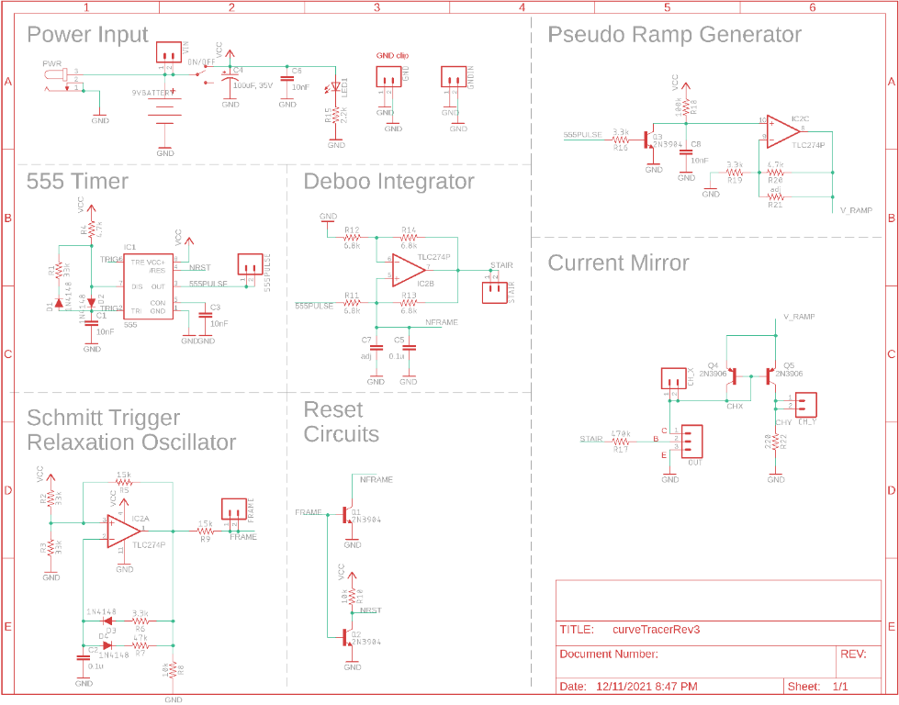
Deboo Integrator
Vout = k * ⌠ vin(t) dt
Interactions
555 Timer to provide voltage
Schmitt Trigger resets integrator

Slide 3
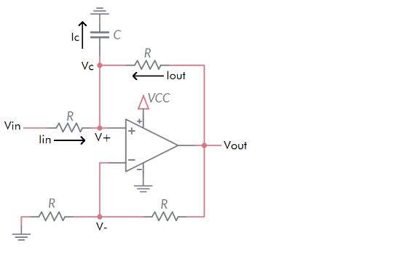

Deboo integrator
$$v_{out}\left(T\right)=k∗\int_{0}^{T}{v_{in}\left(t\right)ⅆt}$$
k will depend on R and C

Slide 4
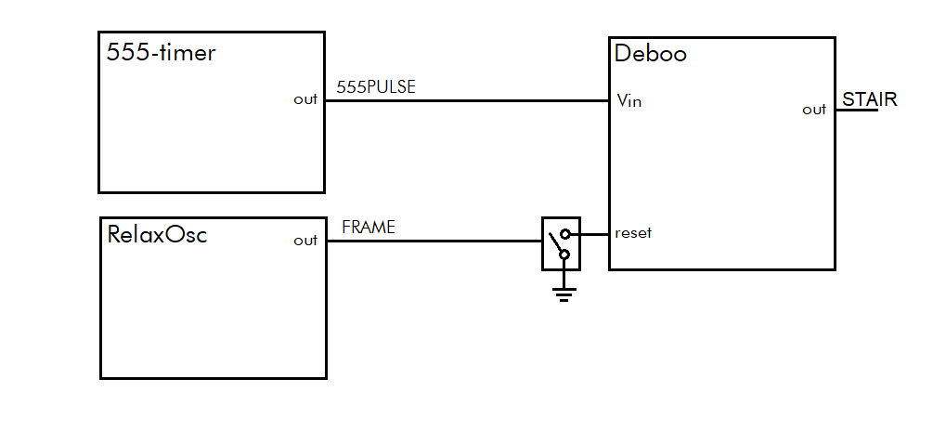
architecture
Deboo Integrator
Integrates 555PULSE creating a staircase waveform
Output voltage reset on high pulse from Schmitt Trig Relax Osc

Slide 5
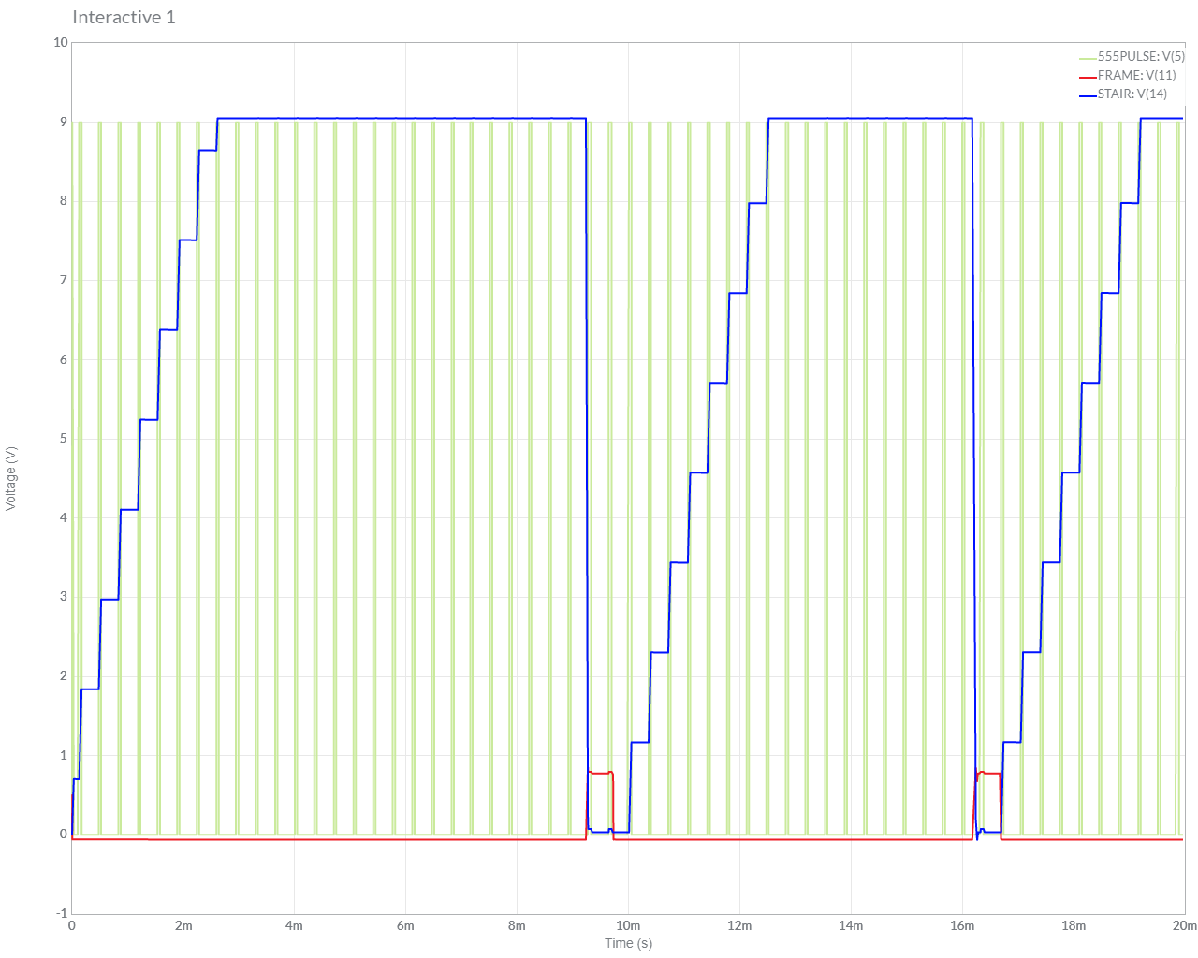
Simulation
Start with Lab 1 or Lab 2 circuit, add components
Set initial conditions on capacitor

Slide 6
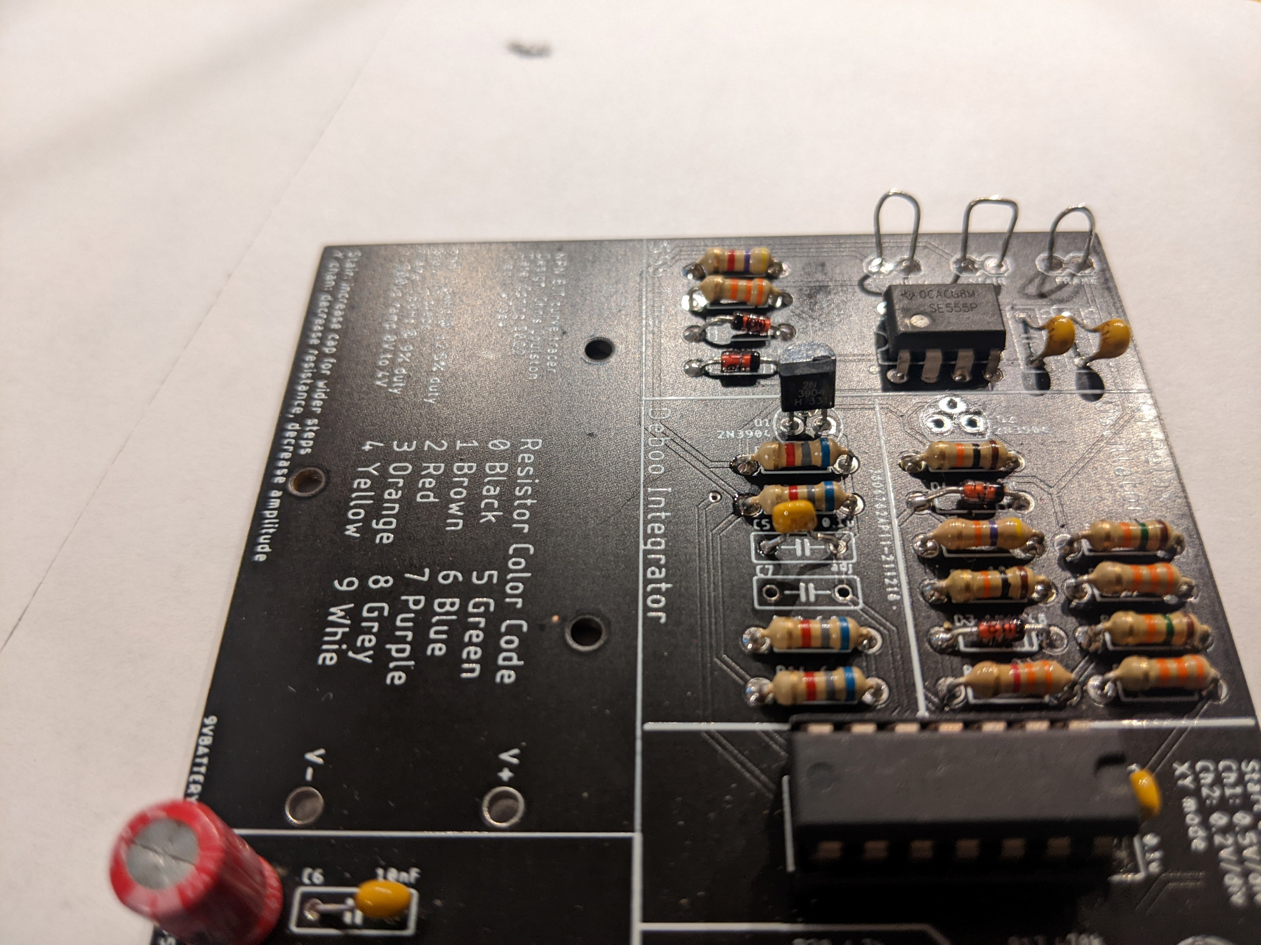
Assemble
MOSFET is polarized
Leave capacitor C7 empty – for now

Slide 7
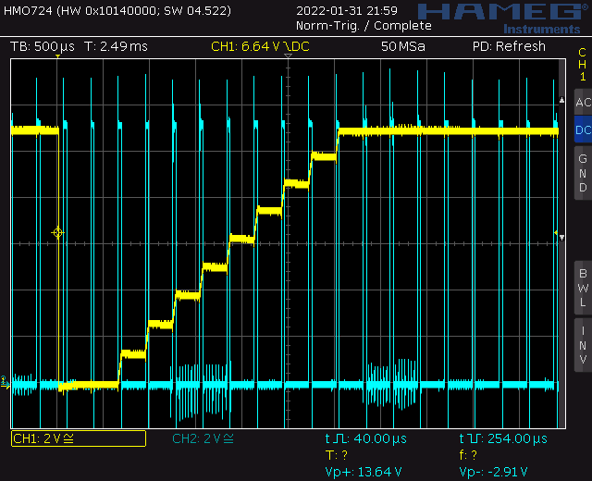
Test
Probe 555TIMER (blue) and STAIR (yellow)
Noisy power supply created chaos
Prefer use lab power supply

Slide 8
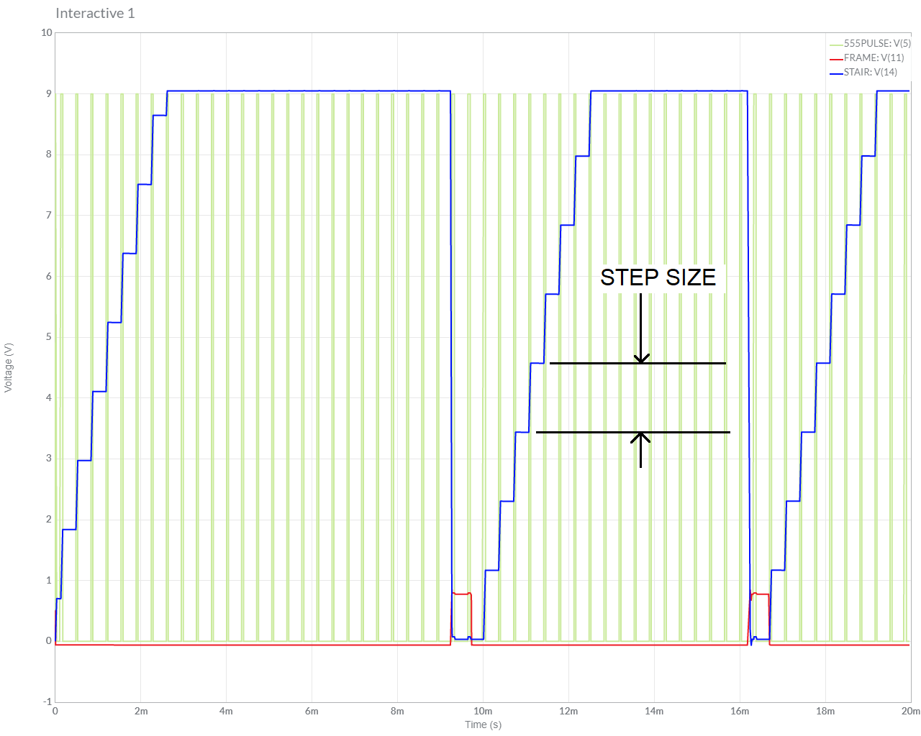
Turn in
Summary of analysis, simulation and assemble
Table 2 Step Size
Answer listed questions
Save solutions as PDF
Due before start of class next week
Every student builds their own board
Everyone brings their board to class

